Slide 1

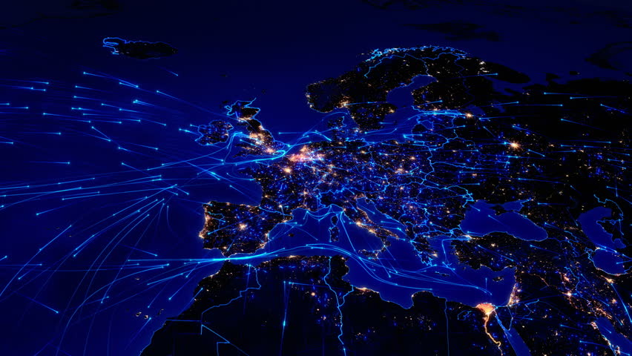
Canadian Trade Database
The Containeers
Trade data to understand global economic growth and trends.

Slide 2





The Containeers
Meet Your
Data Storage Team of Experts
Ghislain Beaulac
Imelda Yumul
Roberta Rios Foltran
Programmer
Marketing Analyst
Engineer
Making Data Storage Tangible
Making Data Storage Lit
Making Big Data Flow

Slide 3

Database Overview

Slide 4
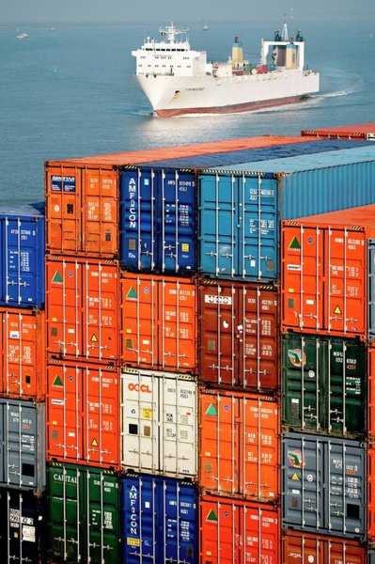
Canada Trade Database
Exchange of commodities between two nations.
As trade originated throughout much of recorded human history, the amount of data that can be gathered is vast and complex.
Trade data for commodities coming in and out Canada shipped in containers and loaded in shipping vessel.

Slide 5


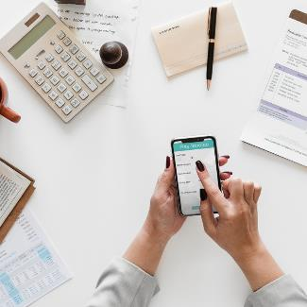
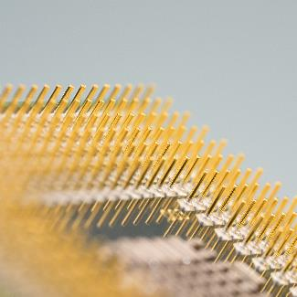
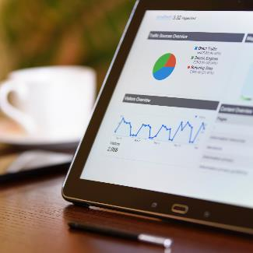
The Problem
Data availability
Data Inconsistency
Data variance
Data Dependency
Scarce Analytics
Lack of Canada centric data
Prone to manual data entry errors.
Different guidelines used in gathering data.
Present limited data available is dependent with other country.
Due to difference in guidelines trade analytics is limited.

Slide 6

Data Dependency
Canadian Trade Database dependent on CBSA data.
Electronic Data Interchange
E-Manifest Portal
Trusted Trader Portal

Slide 7




Assumptions
Data Management System
Data Collection
End Users
How trade data are collected.
What data management system to use.
Expected audience/users of the database.

Slide 8





Limitations & Constraints
Field Length Limit
Data Complexity & Isolation
Domain & Key Constraints
Referential integrity constraints

Slide 9
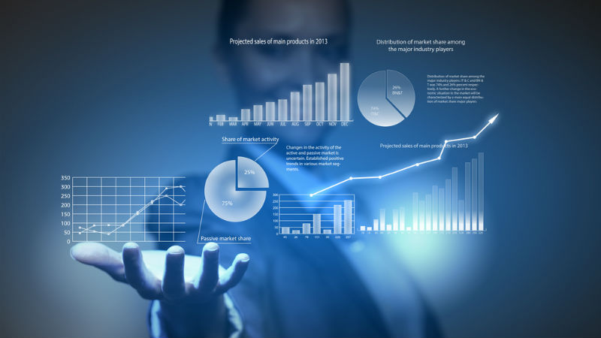
Design Decision

Slide 10


Key Factors Influencing Design
Structured Data Only
Data Volume
Well defined & mainly for analytics

Slide 11
Functional Design Decisions
Import Data Type
End User Experience
“
”
“
”
Upload Process
“
”

Slide 12
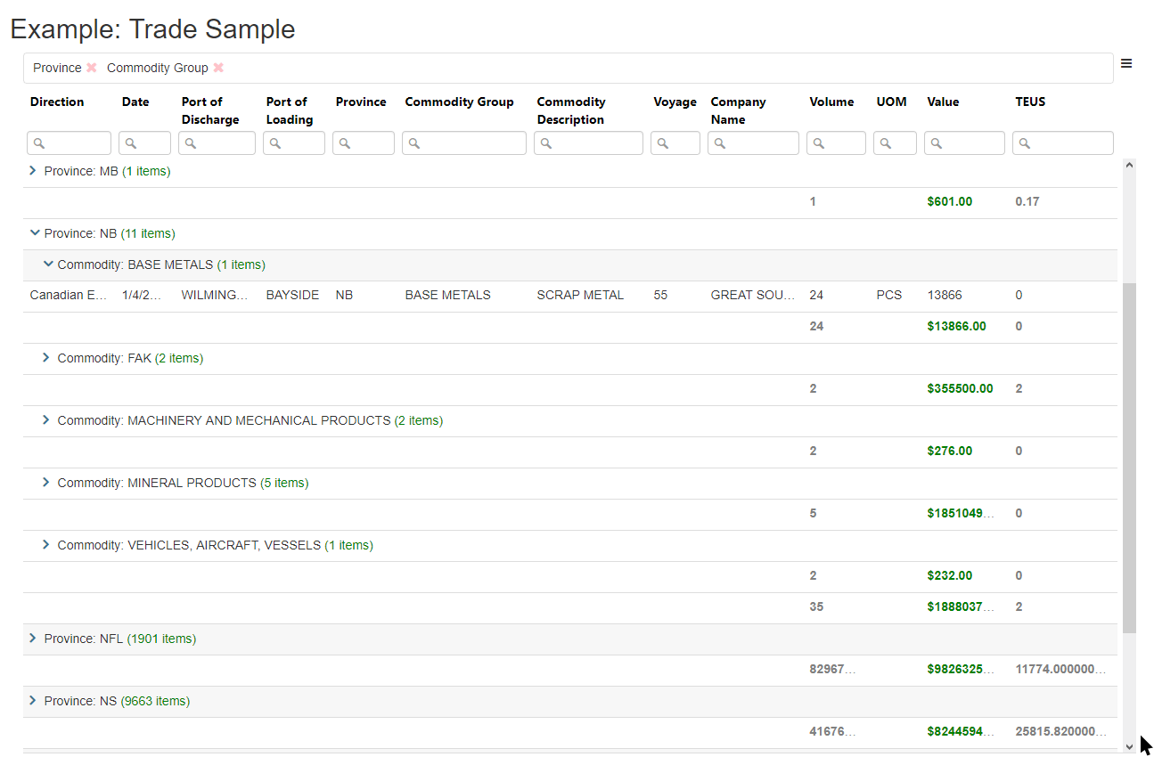

End User Access

Slide 13
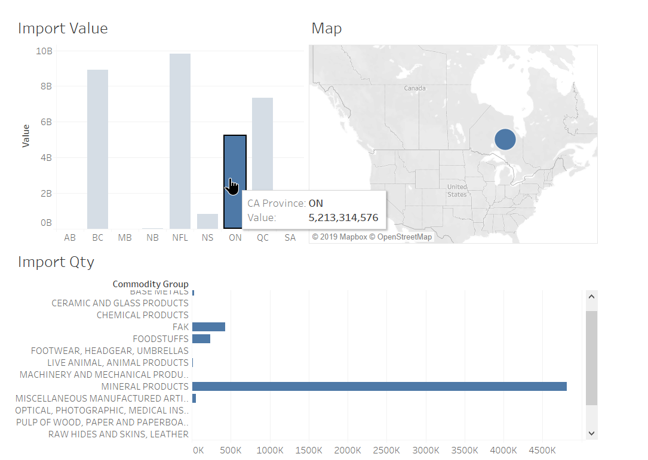
Canadian Trade Dashboard Visualization in Tableau

Slide 14




Database Management System Decisions
Database Choice
Database Transaction
Simple Installation & Automatic Updates
Optimized Security Feature

Slide 15
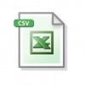

Performance & Maintenance Design Decisions
Database Distribution
Database Uploads
Database Back-up, Restoration & Purging
Consistency
Partition Tolerance
Availability

Slide 16
Detailed Database Design

Slide 17

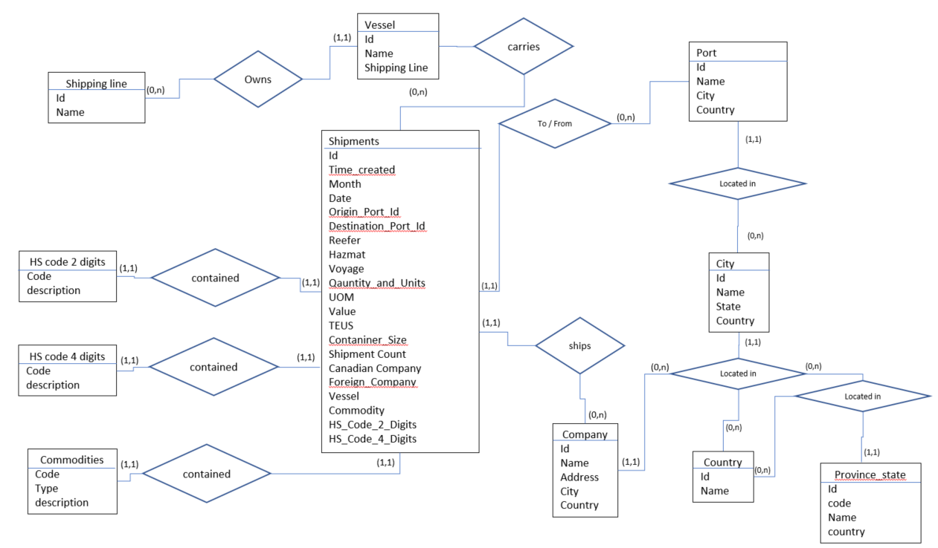
Detailed Database Design

Slide 18
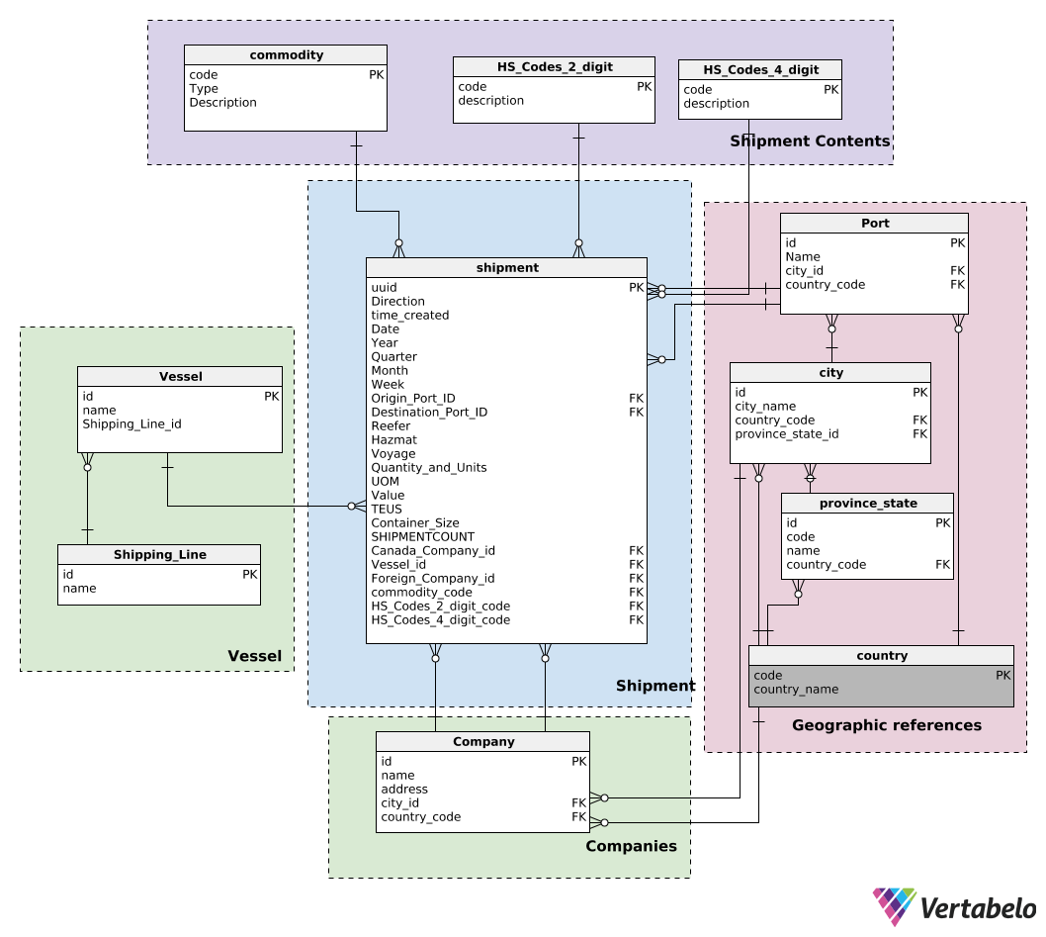
Logical Model & ERD

Slide 19

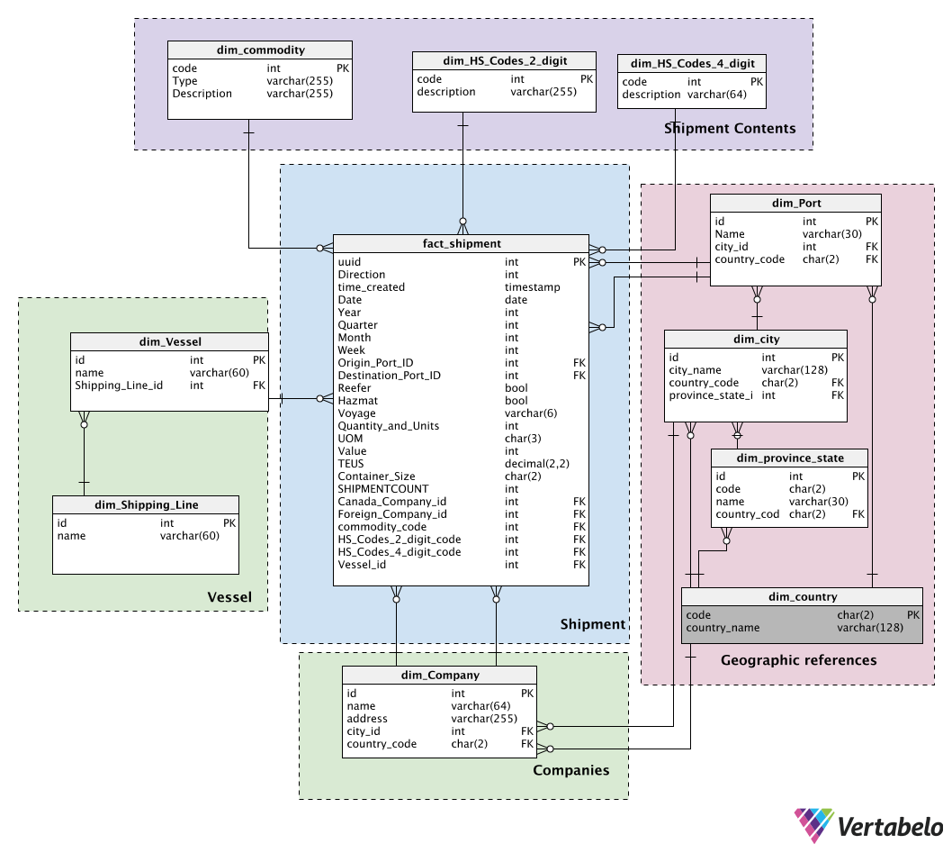
Physical Data Model

Slide 20


Data Volume
Expected transaction in 2019
Expected Transactions in 6 years
Database Number of Tables
Needed Storage

Slide 21





Thank You
The Containeers
Ghislain, Imelda & Roberta
+1 514 – Data Store
deets@datastorage.com
http://www.thecontaineers.data.storage

